Slide 1

Instant3D
Revolutionizing Reconstruction with AI
Computer Vision for Engineers (24-678)
Fall 2023
Team: Phoenix
Prakhar Bhardwaj
Vigknesh Rajan
Shivam Doshi
Mukundan Chariar

Slide 2
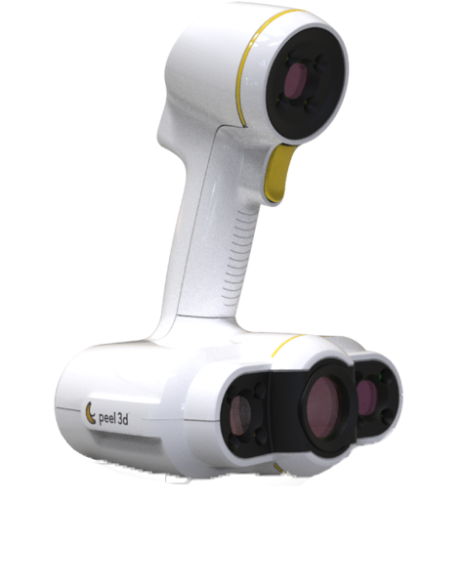
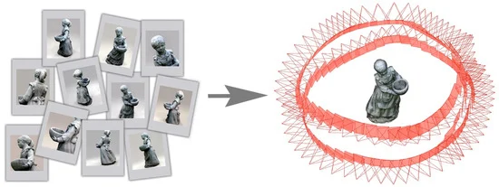
Our startup has pioneered a transformative approach to 3D reconstruction that is both cost-effective and user-friendly.
[1] https://www.robotlab.com/store/peel-2-3d-scanner
[2] Bianco et al., Imaging (2018)

Slide 3
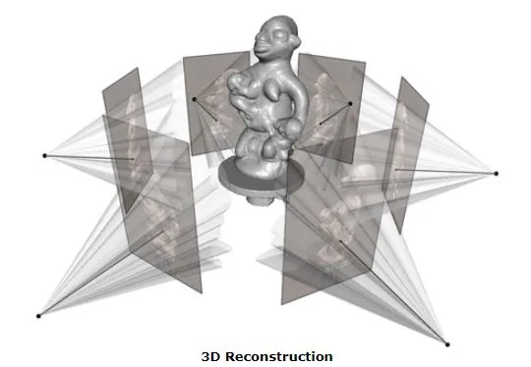
3D Reconstruction combines elements of photogrammetry, computer vision, and computational geometry.
[3] https://medium.com/@dc.aihub/3d-reconstruction-with-stereo-images-part-1-camera-calibration-d86f750a1ade

Slide 4
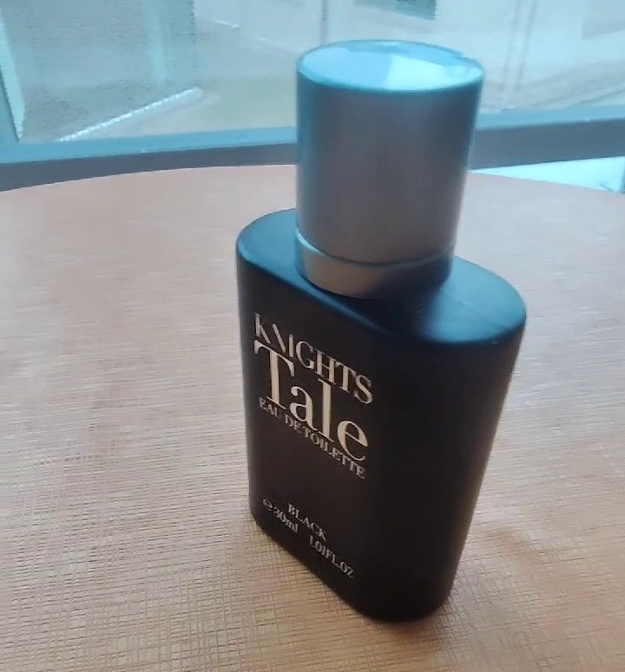
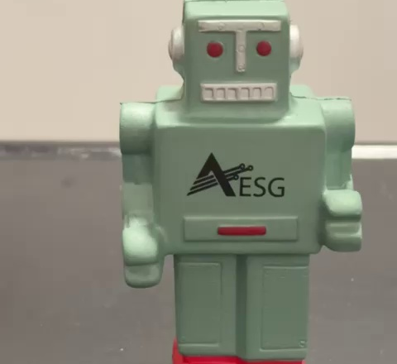
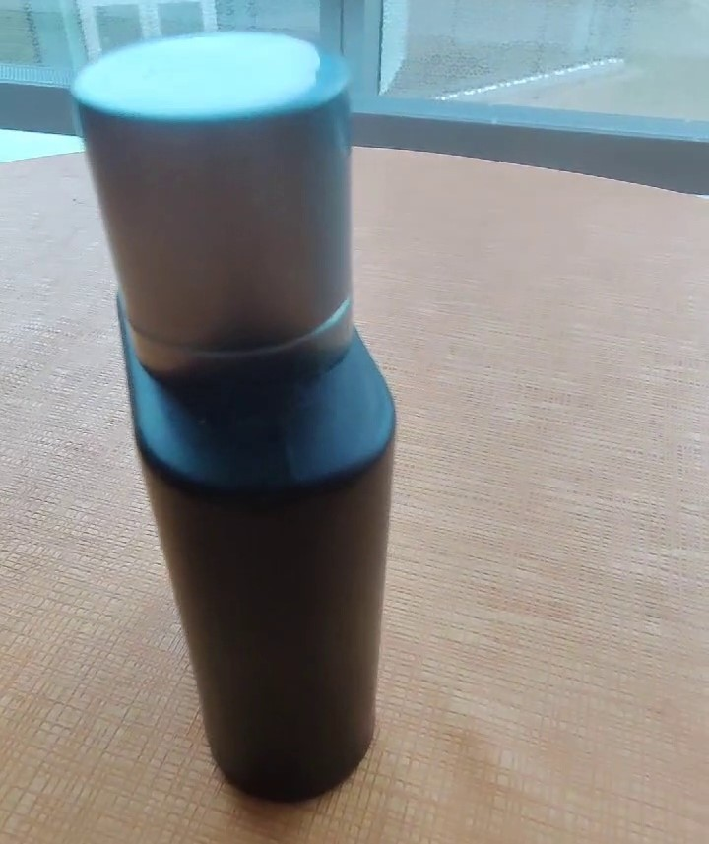
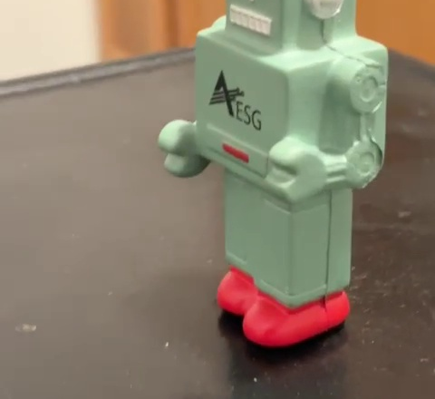

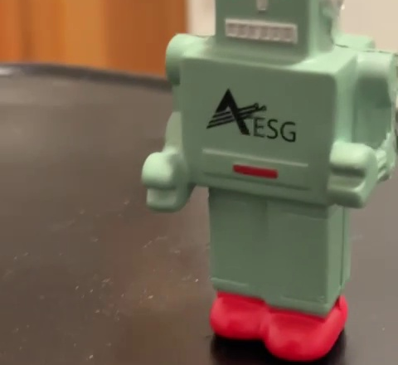
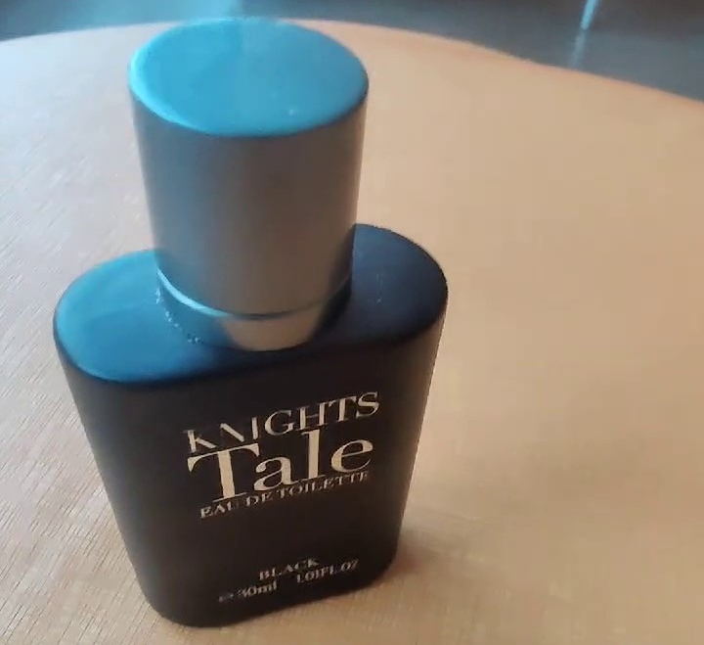
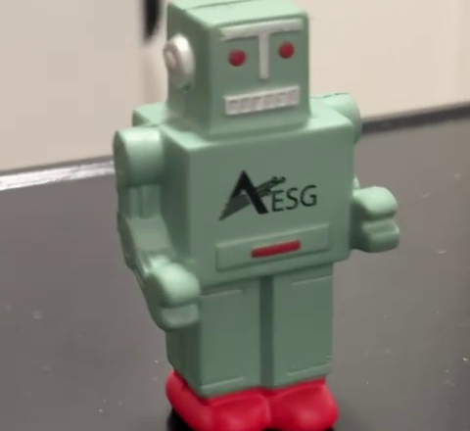
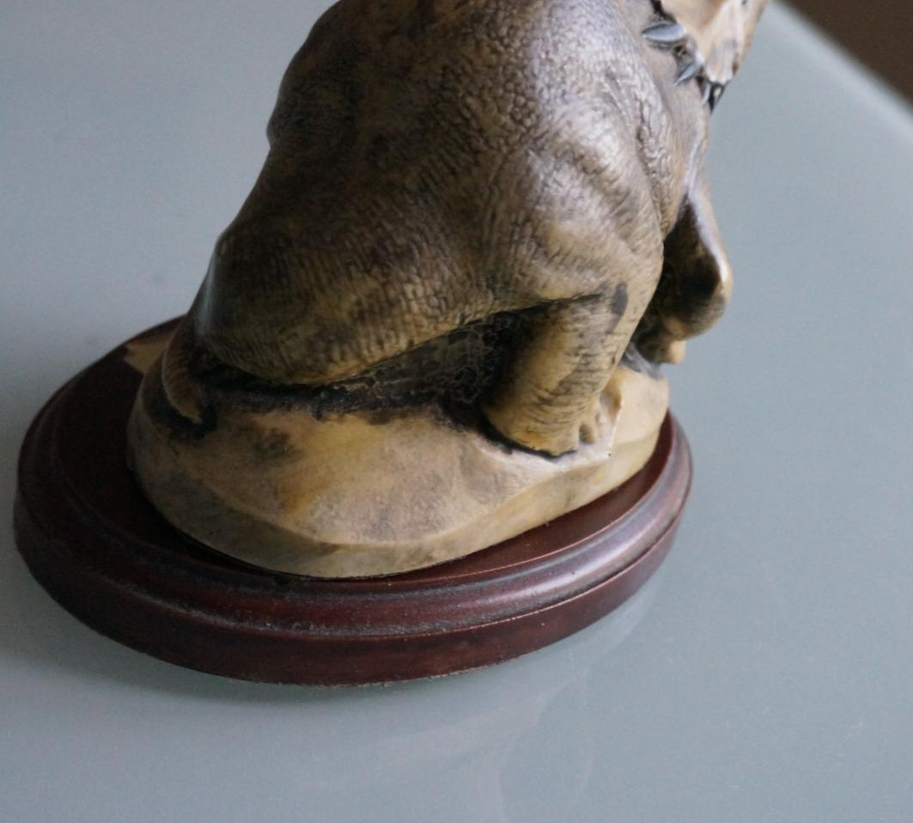
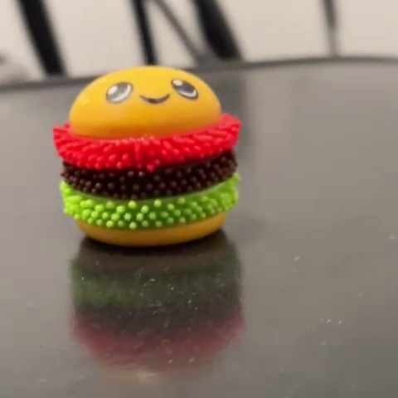
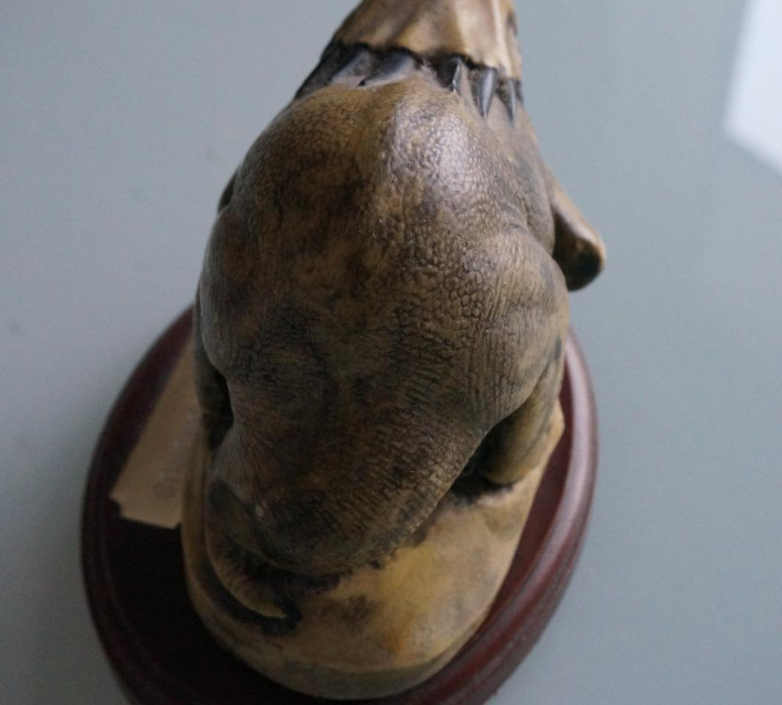
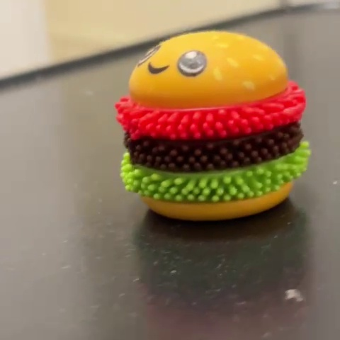
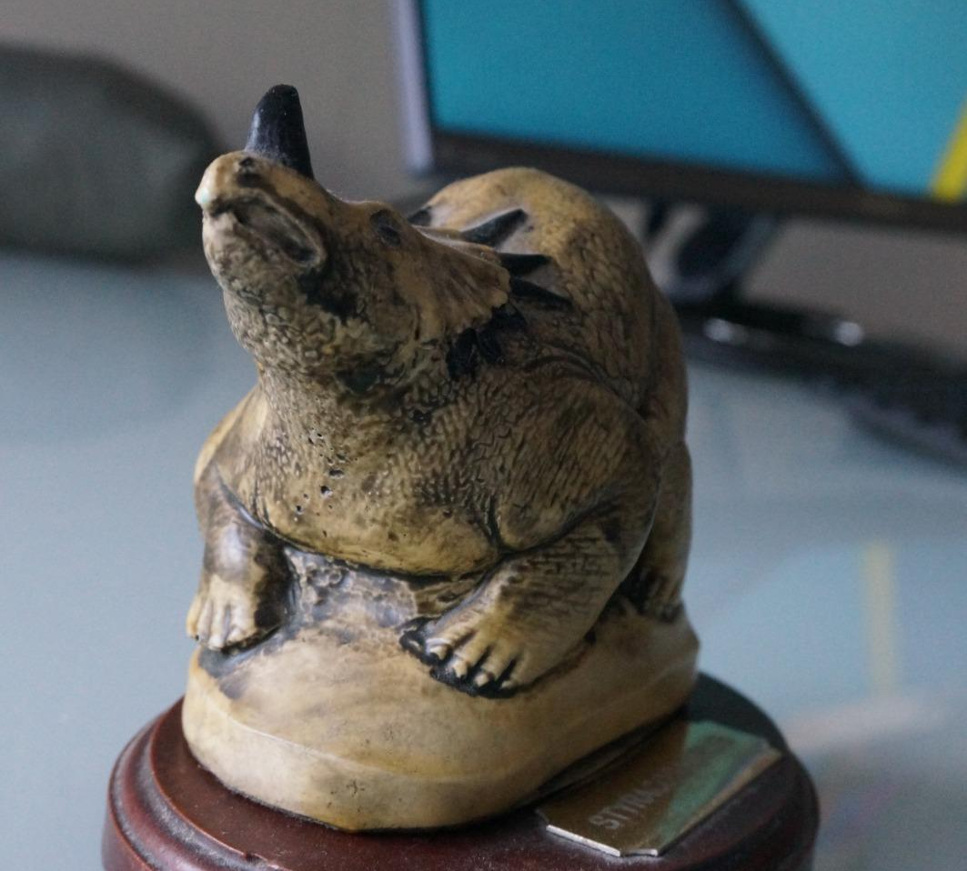
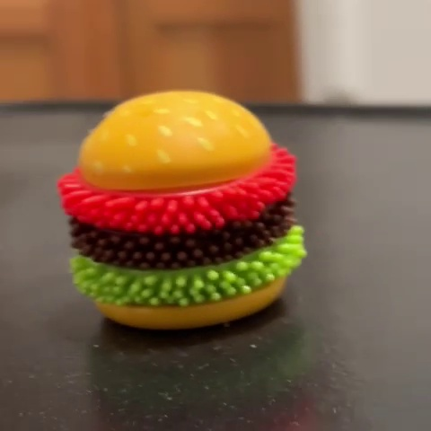
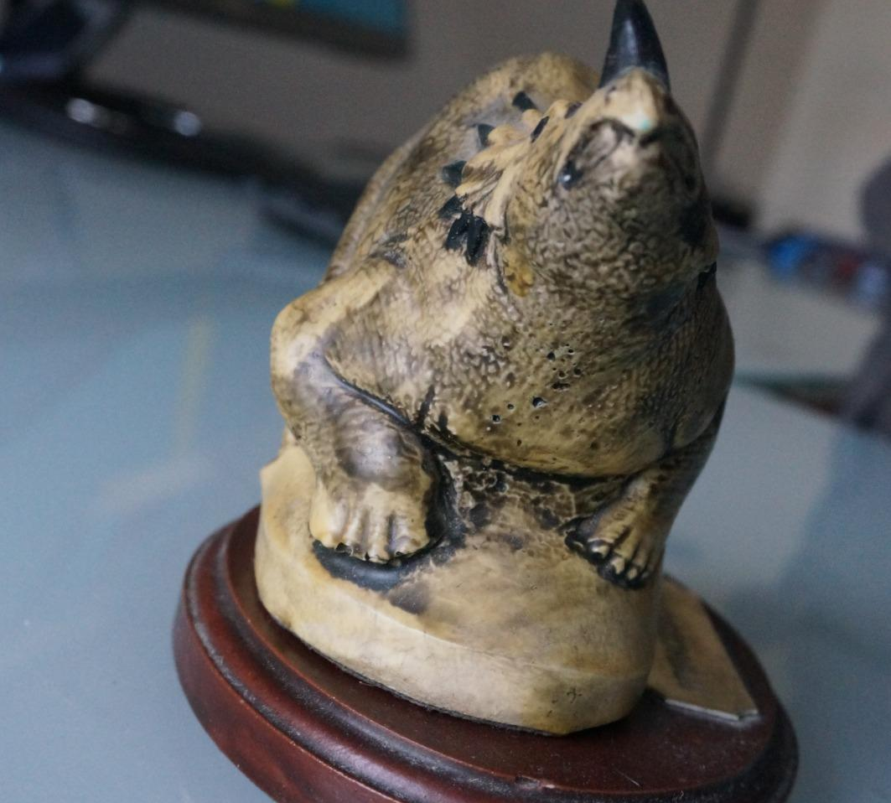
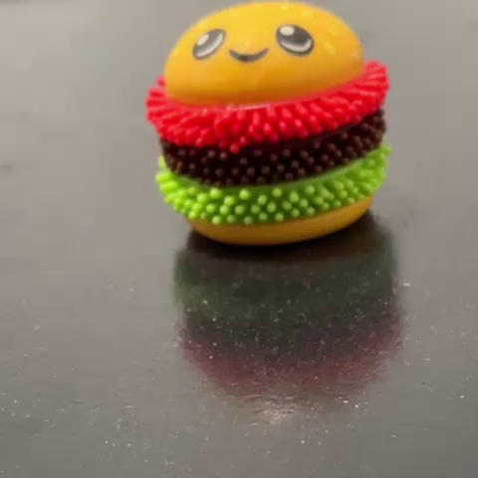
What did we test our methods on?
[4] https://peterfalkingham.com/resources/

Slide 5

Structure from Motion combines views from different viewpoints
object

Slide 6
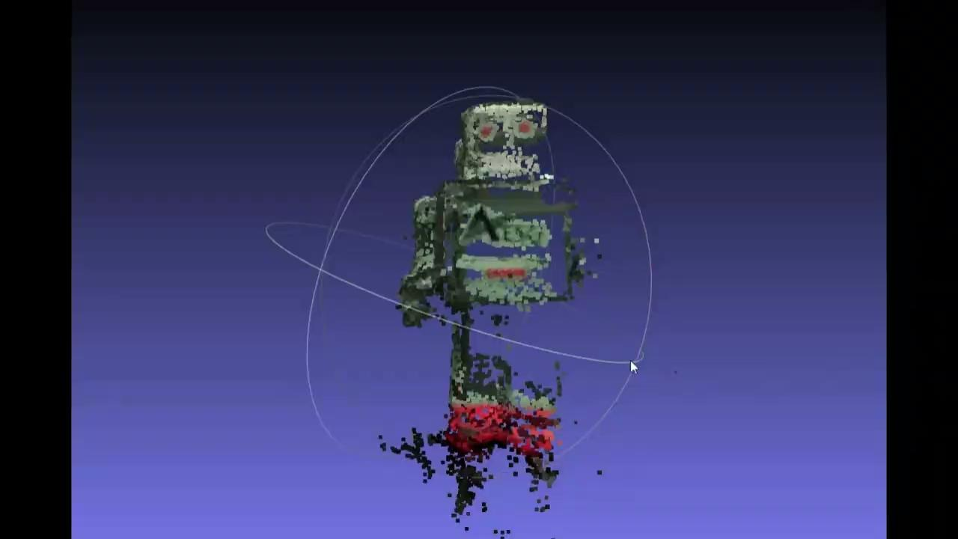
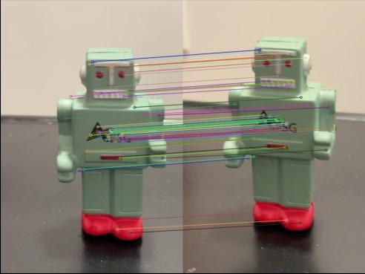
Structure from Motion combines views from different viewpoints
Feature Matching
Fundamental and Essential Matrix
Camera Pose
Triangulation
Perspective n Point
Bundle Adjustment
Fig. Diagram showing the process of Structure from Motion

Slide 7
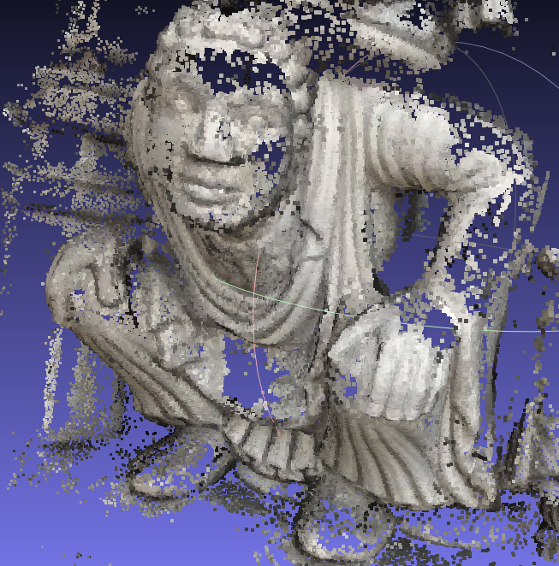
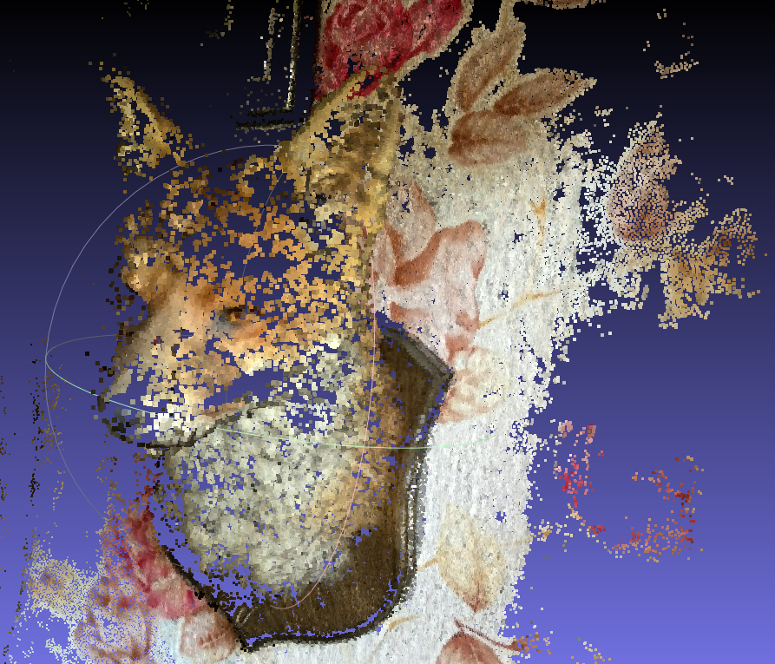
Low Resolution Images Produce Poor Results
Fig. Reconstructed output 1 using images from smartphone cameras
Fig. Reconstructed output 2 using images from smartphone cameras

Slide 8
Parameters that affect SfM
Image Quality and Resolution
Overlap and Coverage
Viewpoint Diversity
Feature Density and Distribution
Lighting Conditions

Slide 9
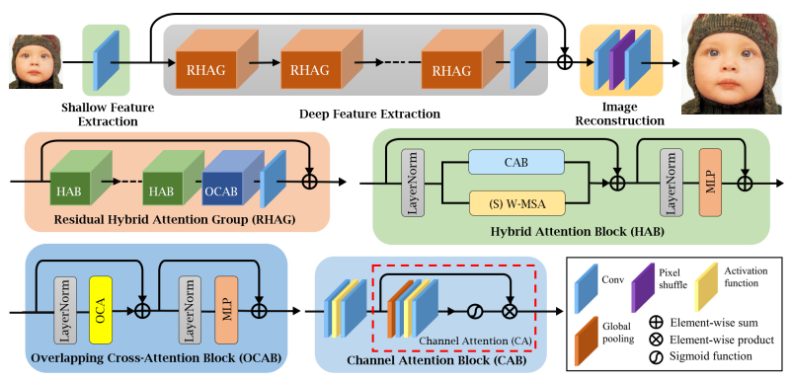
HAT: Hybrid Attention Transformer for Image Restoration
Fig. The overall architecture of HAT and the structure of RHAG and HAB
X. Chen, X. Wang, J. Zhou, Y. Qiao, and C. Dong, “Activating more pixels in image super-resolution Transformer,” arXiv [eess.IV], 2022.

Slide 10
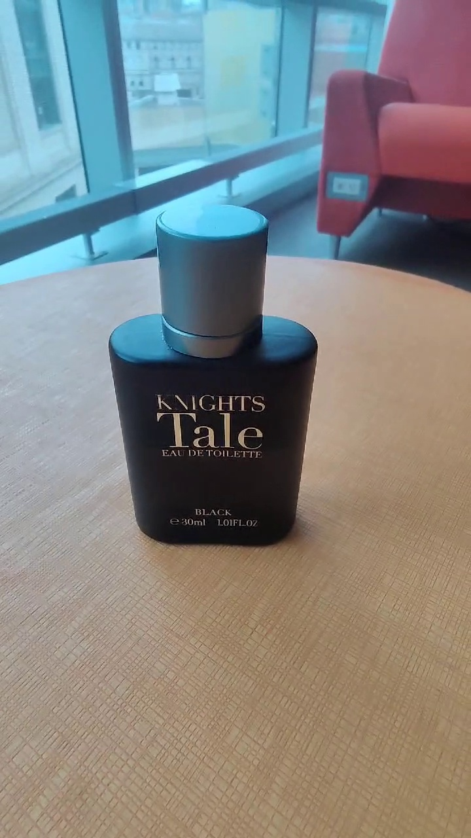
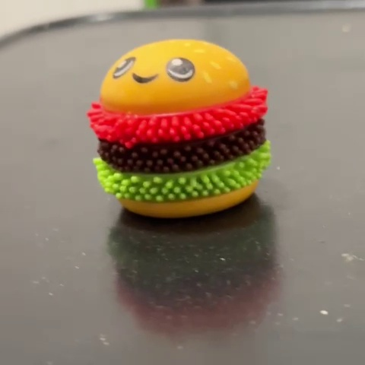
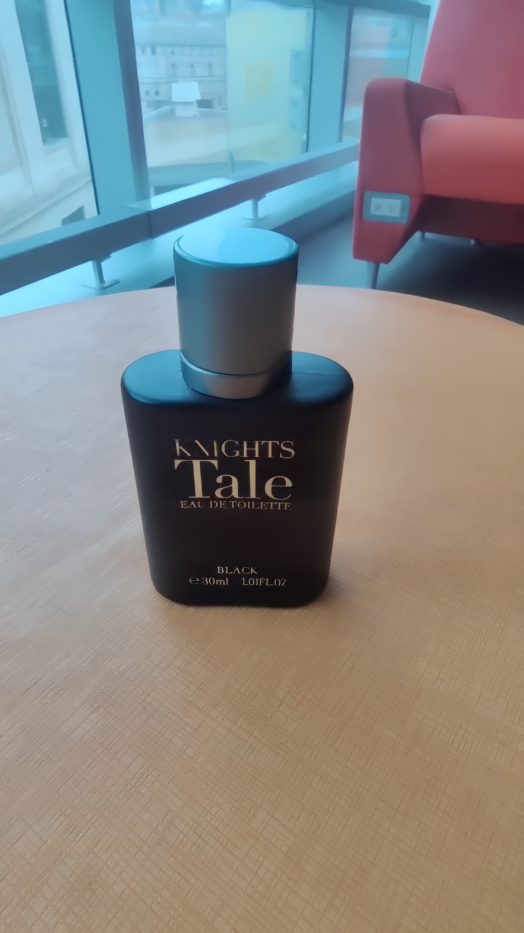
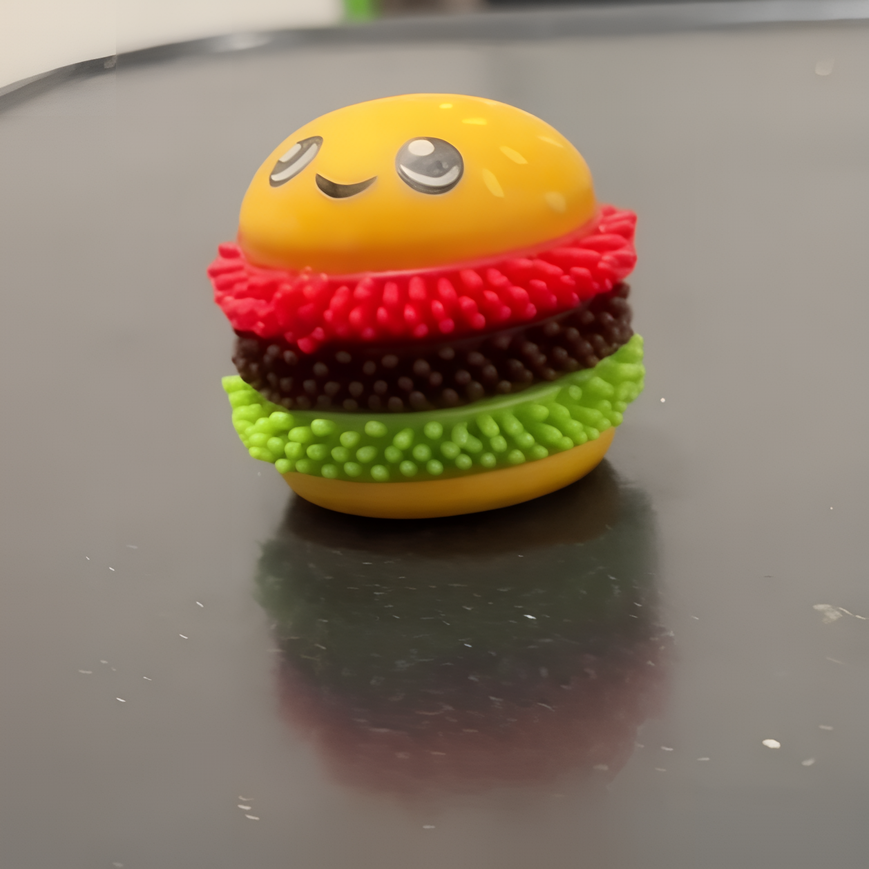
To Produce Better Results We Need to Upsample Our Images
Fig. Original Image 720p upsampled to 3k resolution
Fig. Original Image 480p upsampled to 2k resolution

Slide 11
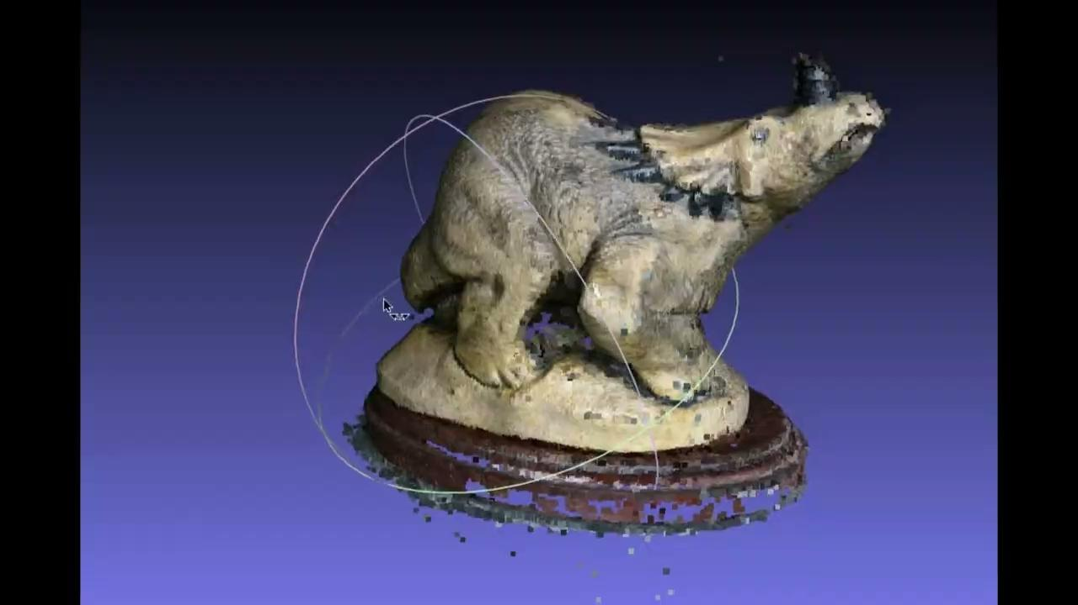
High Resolution Images Produce Better Results

Slide 12
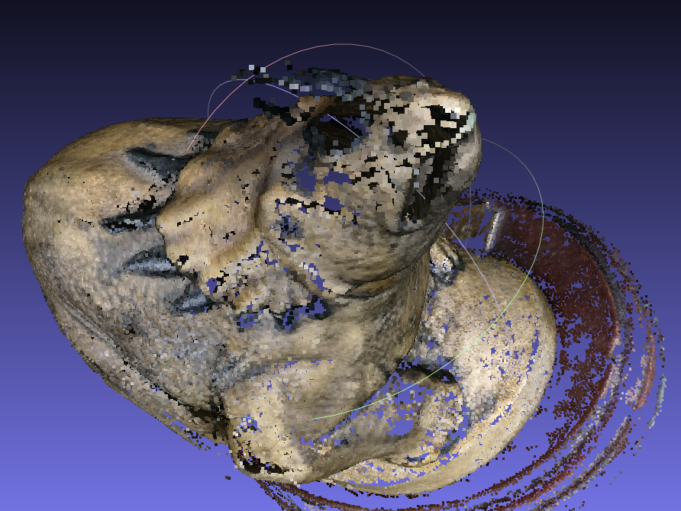
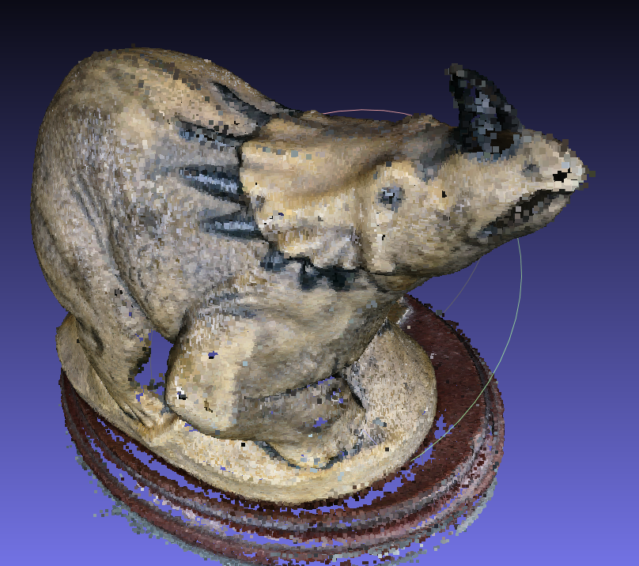
High Resolution Images Produce Better Results
Fig. Reconstructed part using 720p resolution image
Fig. Reconstructed part using 3k upsampled images

Slide 13
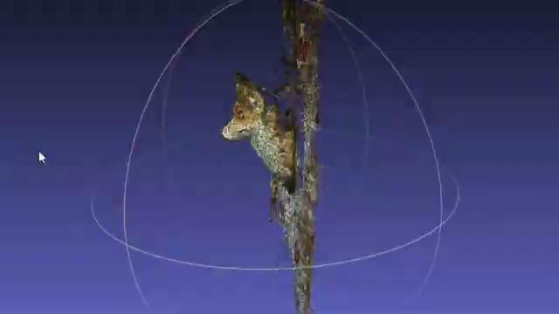
High Resolution Images Produce Better Results

Slide 14
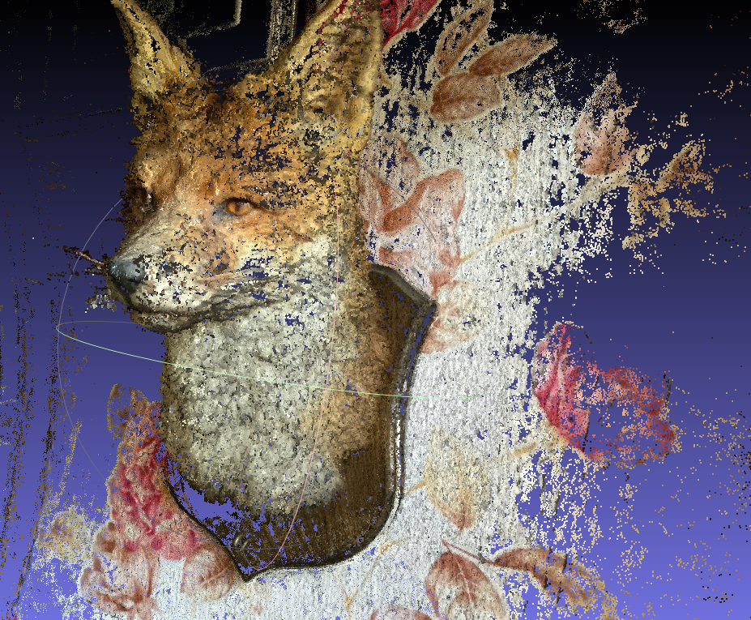
High Resolution Images Produce Better Results
Fig. Reconstructed part using 720p resolution image
Fig. Reconstructed part using 3k upsampled images

Slide 15
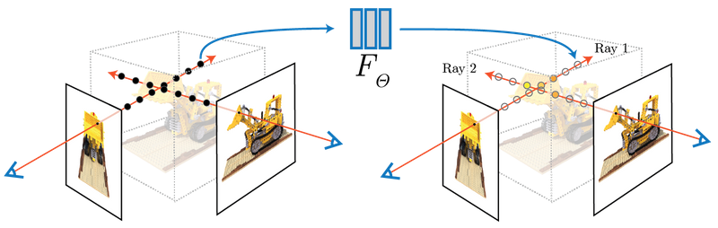
NeRF represents a static scene as a continuous 5D function
[5] https://www.matthewtancik.com/nerf

Slide 16
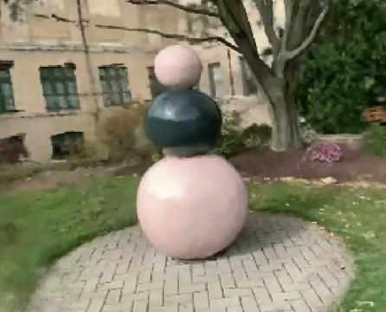


NeRF can produce novel views
[5] https://www.matthewtancik.com/nerf, [6] https://github.com/NVlabs/instant-ngp

Slide 17
Conclusion
 | NERF | SFM
Reconstruction Quality | Dense 3D reconstruction with novel views | Accurate geometric reconstruction
Input Data | Requires substantial training data with various views | Works well even with sparse data
Time | Depends on input image resolution. Typically takes 10-15 hours of training per scene | Depends on input image resolution. Typically takes 30 minutes - 60 minutes per scene

Slide 18
Q&A

